Slide 1
Performance and Processor Design
Week 3

Slide 2
Performance
Performance measures how well a system does its job
You usually need several measures, because "fast" can mean different things
Performance matters to people buying computers, people building software and systems, and everyday users
It depends on the software, especially the operating system, and the hardware, especially the processor

Slide 3
Why GHz Alone Doesn't Tell You How Fast a Computer Is
Historical note: for years, clock speed (GHz) was the number everyone compared. Still worth knowing because it's still printed on every spec sheet
Today, speed also depends on:
  How many cores there are, and how much work each clock tick gets done
  Cache: small, very fast memory right on the processor
  Memory and storage: for many tasks, an SSD makes a bigger difference than a faster processor
  Heat: chips slow themselves down when they get too hot (thermal throttling)
  Software: an efficient operating system and apps
That's why we test with benchmarks instead of comparing numbers on a box
Notes:
IBM: What is a CPU?: https://www.ibm.com/think/topics/central-processing-unit

Slide 4
Why Performance Monitoring and Evaluation Are Needed
Common reasons to evaluate performance:
  Selection: choosing which system to buy
  Projection: predicting how a system that doesn't exist yet will perform
  Monitoring: watching a running system to find problems
Useful when building a system, deciding whether to buy or upgrade, and tuning a system to run better

Slide 5
Performance: External Goals
Goals you can measure from the outside, without looking inside the system
  Throughput: get the most work done
  Response time: respond quickly
  Fairness: every user and process gets a fair share
  Battery life and power use: get the most work done per watt
These goals often conflict. Running faster usually uses more battery

Slide 6
Performance: Internal Goals
Goals for the parts inside the computer
  CPU utilization: the percent of time the CPU is busy
  Disk utilization: the percent of time the drive is busy
  Disk access time: how long one disk request takes
Busy isn't always good: 100% disk use in Task Manager usually means things are waiting

Slide 7
Performance Measures
Absolute measures can be counted, like throughput. Relative measures are judgments, like ease of use
Turnaround time: from submitting a job to getting the result
Response time: from pressing a key or clicking until the system responds
System reaction time: from a request until it first gets CPU time

Slide 8
Performance Measures Examples
Variance in response time: how consistent response times are. A system that's usually fast but sometimes freezes feels slow
Throughput: work done per unit of time
Workload: the amount of work given to the system
Capacity: the most throughput the system can handle
Utilization: the fraction of time a resource is in use

Slide 9
Performance Evaluation Techniques
Different techniques for different purposes
  Some test the whole system, and others test one part
  A thorough evaluation uses more than one technique
Before you start, decide:
  What you're measuring (the metrics)
  Under what workload
  And why: what question are you trying to answer?

Slide 10
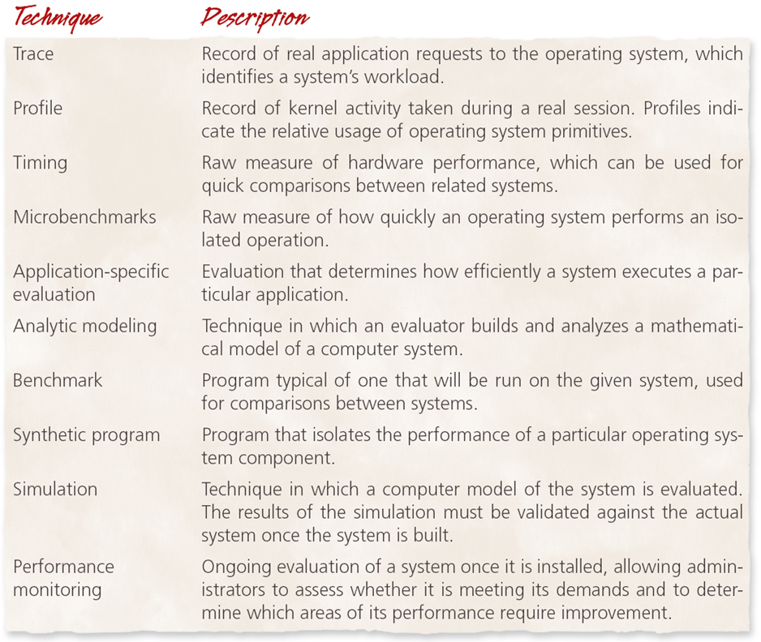
Evaluation Techniques at a Glance
This table sums up the main techniques
The next two slides group them into measuring a real system and predicting performance

Slide 11
Measuring a Real System
Benchmarks: run a standard test and compare the score
Monitoring: watch a running system with tools like Task Manager or top
Profiling: find which parts of the OS or a program use the most time
Tracing: record every request, to replay or study later
Timings and microbenchmarks: measure one small thing, like how long it takes to start a process

Slide 12
Predicting Performance
Simulation: a computer model of the system, useful before it's built
  Results must be checked against the real system, and bugs in the model give wrong answers
Analytic models: math models, such as queuing theory (the math of waiting in lines)
  Fast, but real systems are often too complex to model exactly
Synthetic programs: fake programs built to test one part, such as memory speed

Slide 13
Benchmarks
Run a standard program and time it, so systems can be compared fairly
A good benchmark gives nearly the same result each run, and matches what you'll actually use the system for
Industry standards: SPEC for processors and servers, and TPC for databases
Ones you may see in reviews: Geekbench, Cinebench, and 3DMark
On Linux: the free Phoronix Test Suite
Notes:
SPEC: https://www.spec.org/
3DMark: https://www.3dmark.com/
Phoronix Test Suite: https://www.phoronix-test-suite.com/

Slide 14
Can You Trust a Benchmark?
Some companies have tuned devices to score higher on benchmarks than in normal use
  In 2026, UL, the maker of 3DMark, delisted the RedMagic 11 Pro phones. They spotted the benchmark app by name and scored up to 24% higher
Ask who ran the test, and why
Check whether real-world tests agree with the benchmark score
Notes:
UL: 3DMark delisting of REDMAGIC 11 Pro phones: https://benchmarks.ul.com/news/3dmark-delisting-of-redmagic-11-pro-phones

Slide 15
Performance Monitoring
Monitoring finds slow spots that administrators and developers can fix
Software monitors
  Windows: Task Manager, Resource Monitor, and Performance Monitor
  macOS: Activity Monitor
  Linux: top, htop, free (memory), vmstat, iostat (drives), and the /proc folder
  Monitors use resources themselves, so they can change the results slightly
Hardware monitors
  Counters built into the processor record events like cache misses
  On Linux, the perf tool reads them
Notes:
Microsoft: perfmon: https://learn.microsoft.com/en-us/windows-server/administration/windows-commands/perfmon
Apple: Activity Monitor User Guide: https://support.apple.com/guide/activity-monitor/welcome/mac
Linux manual page: vmstat: https://man7.org/linux/man-pages/man8/vmstat.8.html
perf wiki: https://perfwiki.github.io/

Slide 16
Bottlenecks and Saturation
Bottleneck: the slowest part, holding everything else back
  Work arrives faster than it can be handled
  Fixing one bottleneck can reveal the next one
Everyday examples
  Task Manager shows the disk at 100% while everything feels slow
  RAM is full, so the system starts using the drive as extra memory (swapping)
  Slow Wi-Fi makes a fast computer feel slow online
Saturated resource: so busy that processes get in each other's way. When memory is saturated, it's called thrashing (Week 11)

Slide 17
Feedback Loops
Feedback loop: information about how busy the system is changes where new work goes
Negative feedback pushes things back toward balance (negative doesn't mean bad)
  Like a maps app: when one road jams up, it sends drivers another way, so the jam doesn't get worse
  In a computer: when one server's line is long, new work goes to a less busy one
Positive feedback pushes things further the same way, and can be misleading
  If the CPU looks idle, the scheduler may add more processes
  But low CPU use can be caused by thrashing, so adding processes makes it even worse
Notes:
Google: How AI helps predict traffic and determine routes: https://blog.google/products-and-platforms/products/maps/google-maps-101-how-ai-helps-predict-traffic-and-determine-routes/

Slide 18
What Is an Instruction Set?
An instruction set is the list of basic commands a processor understands, such as add, compare, or load from memory
Programs are translated (compiled) into machine code: the 1s and 0s for one instruction set
The two big families today are x86 and ARM
An operating system has to be built separately for each one. That's why Linux distros offer x86 (amd64) and ARM (arm64) versions
Notes:
Debian: Ports: https://www.debian.org/ports/

Slide 19
CISC and RISC
CISC (complex instruction set computer): many instructions, some doing a lot of work in one step
  x86 processors from Intel and AMD
RISC (reduced instruction set computer): fewer, simpler instructions that each run very fast
  ARM and RISC-V processors
The line has blurred: modern x86 chips break complex instructions into simpler, RISC-like steps inside
Notes:
Arm: CPU architecture: https://www.arm.com/architecture/cpu

Slide 20
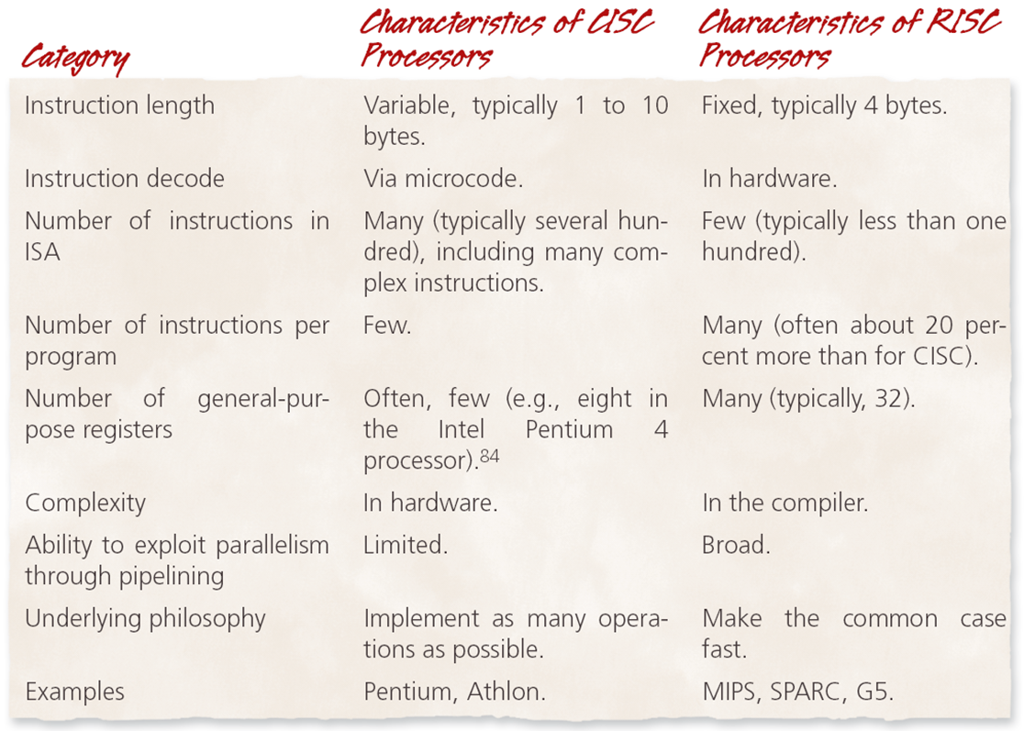
RISC and CISC: The Classic Comparison
Historical note: this table is from the mid-2000s, and its examples (Pentium, Athlon, MIPS, SPARC, G5) are mostly retired
Still worth knowing because terms like pipelining and registers are still used today

Slide 21
Processors Today
x86-64 (Intel and AMD): most Windows PCs, older Macs, and many servers
ARM: almost every phone and tablet, Apple silicon Macs, Windows on ARM laptops, and cloud servers like AWS Graviton
  Known for good performance per watt, which means long battery life
RISC-V: an open design anyone can use without paying license fees, growing especially in small and embedded devices
Notes:
AWS Graviton: https://aws.amazon.com/ec2/graviton/
RISC-V International: About RISC-V: https://riscv.org/about/

Slide 22
Why Programs Don't Just Swap Between ARM and x86
A program's machine code is written for one instruction set, like a recipe in a language the cook can't read
Ways around it:
  Translation (emulation): Rosetta 2 on Macs, and Prism on Windows. Works for most apps, but can be slower
  Apps built for both: Apple's Universal apps
  Rebuild the program for each type: Linux distros offer separate packages
Web apps, and programs in languages like Python and Java, run anywhere, because the browser or the language translates for them
What still breaks: drivers can't be translated, so some printers, and games whose anti-cheat runs as a driver, may not work on ARM laptops
Notes:
Microsoft: How emulation works on Arm: https://learn.microsoft.com/en-us/windows/arm/apps-on-arm-x86-emulation
Apple: Using Intel-based apps on a Mac with Apple silicon: https://support.apple.com/en-us/102527

Slide 23
Beyond the CPU
GPUs (graphics processing units): thousands of small cores, built for graphics and now also used for AI
NPUs (neural processing units): chips built for AI tasks, now in many laptops and phones
  Windows Copilot+ PCs require one, and Apple calls theirs the Neural Engine
The OS has to decide which work goes to which chip, and manage the power each one uses
Notes:
IBM: What is a GPU?: https://www.ibm.com/think/topics/gpu
Microsoft: Copilot+ PCs developer guide: https://learn.microsoft.com/en-us/windows/ai/npu-devices/

